Slide 1

Society management
Mentor name : Ruchika Rami

Slide 2
Role of team members
Hemali gosaliya – IT19A14
Parth parekh – IT19B32
Rajan shah – IT19B46
Sagar khunt – IT19B57
Analysis by All Member

Slide 3
Abstract of definition
We are going to make a society maintenance or management system for reduce the time or paper work .
This Application built both side secretary side and users side, users can advance book the party hall, garden and secretary can manage the maintenance and events , notifications. Users can view notifications through the OTP system.

Slide 4
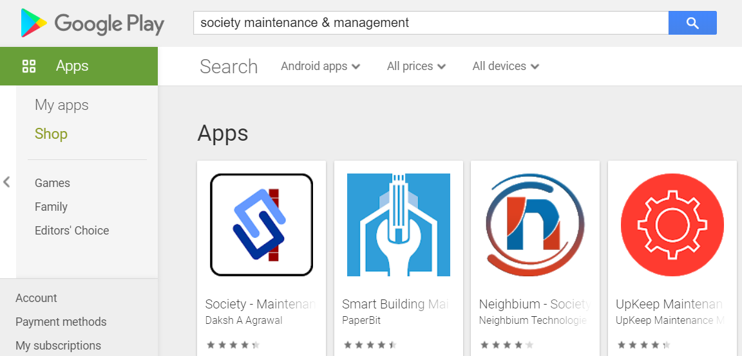
Study of similar ideas in the market

Slide 5
1. tbladmin
Field name | Data type | Size | Constraint | Description
ID | INT | 10 | PK
AdminName | VARCHAR | 120 | DEFAULT NULL
UserName | VARCHAR | 120 | DEFAULT NULL
MobileNumber | BIGINT | 11 | DEFAULT NULL
Email | VARCHAR | 200 | DEFAULT NULL
Password | VARCHAR | 200 | DEFAULT NULL
AdminRegdate | TIMESTAMP |  | NULL DEFAULT
2. tblallotment
Field name | Data type | Size | Constraint | Description
ID | INT | 10 | PK
Name | VARCHAR | 200 | DEFAULT NULL
ContactNumber | BIGINT | 10 | DEFAULT NULL
Block | VARCHAR | 10 | DEFAULT NULL
FlateNum | INT | 10 | DEFAULT NULL
Econtactnum | BIGINT | 10 | DEFAULT NULL
Noofmember | INT | 10 | DEFAULT NULL
Address | MEDIUMTEXT |  | DEFAULT NULL
AllotmentDate | TIMESTAMP |  | NULL DEFAULT

Slide 6
3. tblamenities
Field name | Data type | Size | Constraint | Description
Said | INT | 20 | FK
Aid | INT | 20 | PK
Contact | VARCHAR | 50 | NOT NULL
Email | VARCHAR | 255 | NOT NULL
Flateno | VARCHAR | 10 | NOT NULL
Block | VA4RCHAR | 10 | NOT NULL
Date | DATE |  | NOT NULL
4. showamenities
Field name | Data type | Size | Constraint | Description
said | INT | 20 | PK
image | VARCHAR | 255 | NOT NULL
name | VARCHAR | 50 | NOT NULL

Slide 7
5. tblflat
Field name | Data type | Size | Constraint | Description
ID | INT | 10 | PK
FlatNum | INT | 50 | PK
Floor | VARCHAR | 50 | DEFAULT NULL
Block | VARCHAR | 50 | DEFAULT NULL
FlatType | VARCHAR | 120 | DEFAULT NULL
Mcharge | VARCHAR | 200 | DEFAULT NULL
CreationDate | TIMESTAMP |  | NULL DEFAULT
6. tblblocks
Field name | Data type | Size | Constraint | Description
ID | INT | 10 | PK
BlockName | VARCHAR | 25 | DEFAULT NULL

Slide 8
7. tblgalary
Field name | Data type | Size | Constraint | Description
ID | INT | 255 | PK
Name | VARCHAR | 255 | NOT NULL
8. tblevent
Field name | Data type | Size | Constraint | Description
ID | INT | 10 | PK
Name | VARCHAR | 50 | NOT NULL
Description | VARCHAR | 500 | NOT NULL

Slide 9
9. tblbill
Field name | Data type | Size | Constraint | Description
ID | INT | 10 | PK
Block | VARCHAR | 20 | FK
FlateNum | INT | 10 | FK
PricepUnit | INT | 10 | DEFAULT NULL
UnitCons | INT | 10 | DEFAULT NULL
Echarge | VARCHAR | 50 | DEFAULT NULL
BillDate | TIMESTAMP | - | NULL DEFAULT
10. tblcomplain
Field name | Data type | Size | Constraint | Description
Id | INT | 10 | PK
RequestID | INT | 10 | DEFAULT NULL
UserID | INT | 10 | DEFAULT NULL
ComplainType | VARCHAR | 200 | DEFAULT NULL
CompRaisedate | MEDIUMTEXT | - | DEFAULT NULL
AdminRemark | TIMESTAMP | - | DEFAULT NULL
Status | VARCHAR | 200 | DEFAULT NULL
ResolvedDate | TIMESTAMP | - | DEFAULT NULL
Notes:
Event
Field name
Data type
Size
Constraint
Description
Festival_ID
INT
10
PK
events
wing_ID
INT
10
FK
-
Name
VARCHAR
20
NOTNULL
-
Type
INT
5
NOTNULL
0 for perticular building function or 1 for all building festival.
message
VARCHAR
50
NOTNULL
-
Starting_time
Time
-
NOTNULL
-
Ending_time
Time
-
NOTNULL
-
Starating_date
Date
-
NOTNULL
-
Ending_date
Date
-
NOTNLL
Ending date

Slide 10
11. tblvisitor
Field name | Data type | Size | Constraint | Description
ID | INT | 10 | PK
VisitorName | VARCHAR | 200 | DEFAULT NULL
MobileNumber | BIGINT | 10 | DEFAULT NULL
Address | MEDIUMTEXT | - | DEFAULT NULL
WhomtoMeet | VARCHAR | 200 | DEFAULT NULL
ReasontoMeet | MEDIUMTEXT | - | DEFAULT NULL
Block | VARCHAR | 50 | DEFAULT NULL
FlatNum | INT | 10 | FK
EnterDate | TIMESTAMP | - | NULL DEFAULT
Remark | VARCHAR | 200 | DEFAULT NULL
Outtimr | TIMESTAMP | - | NULL DEFAULT

Slide 11
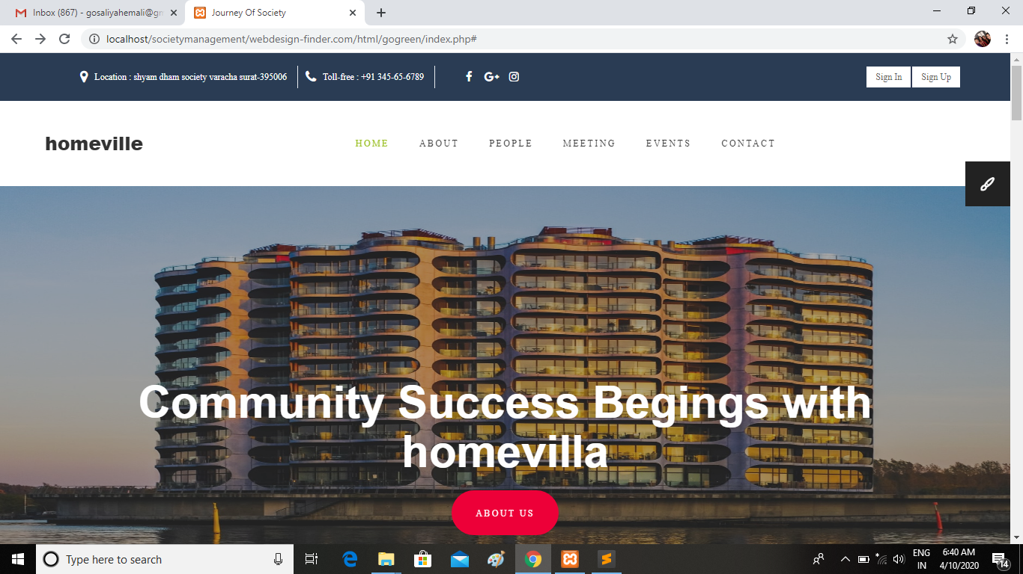
Index Page

Slide 12
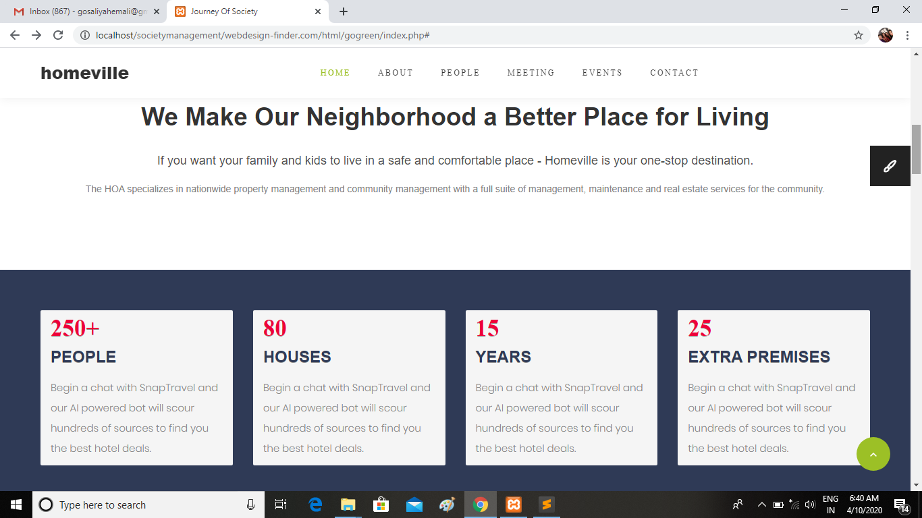

Slide 13
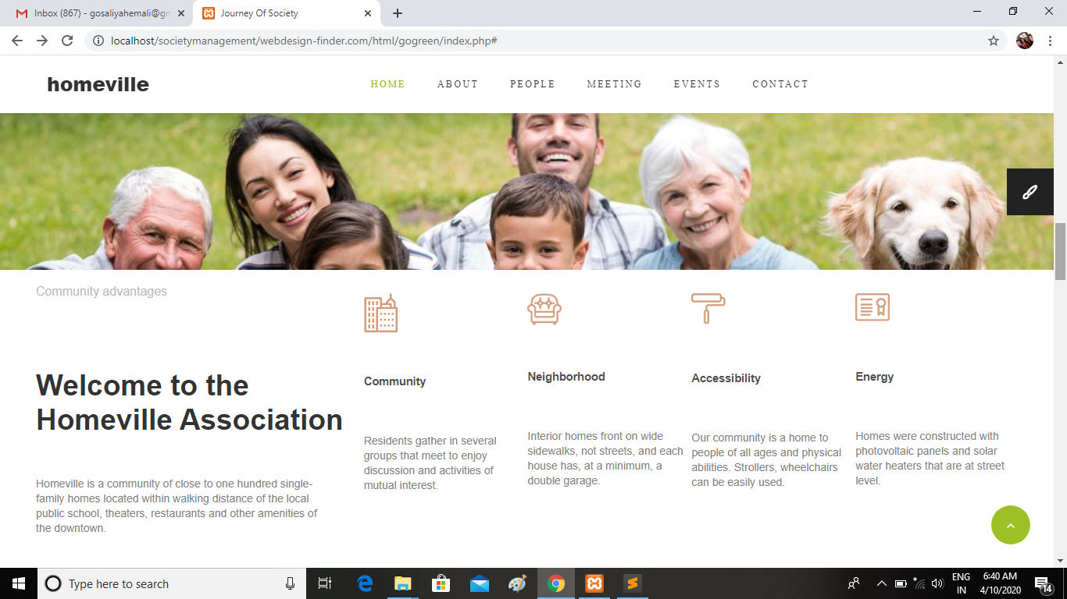

Slide 14
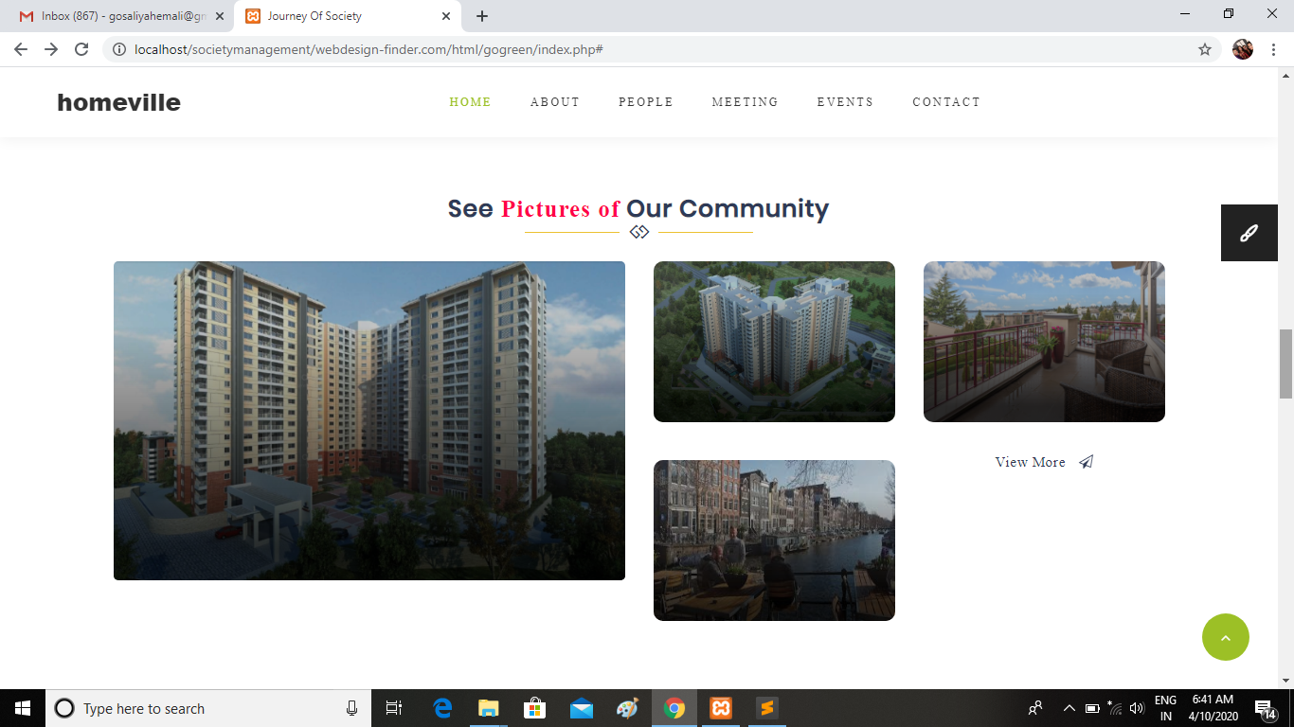

Slide 15
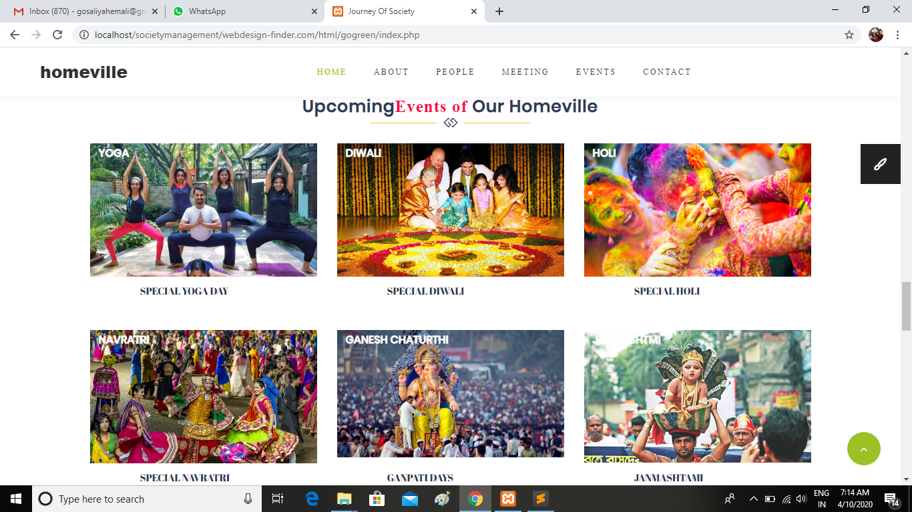

Slide 16
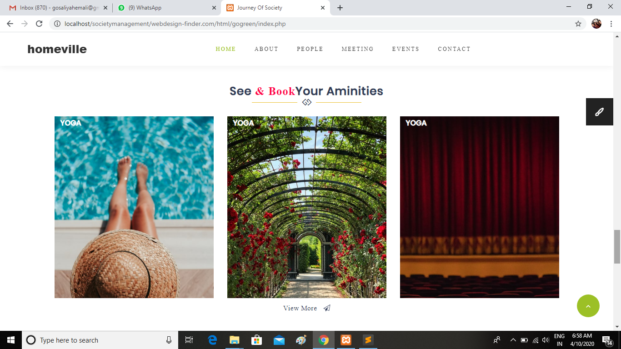

Slide 17
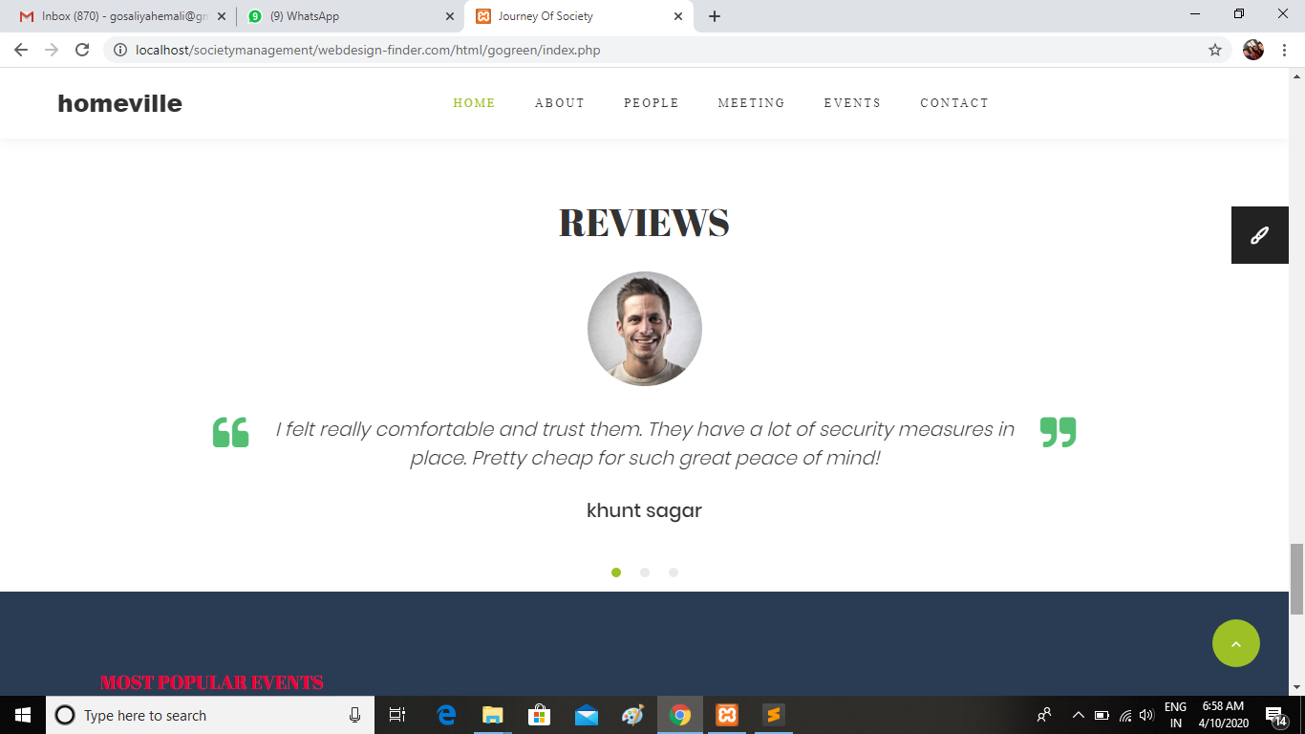

Slide 18
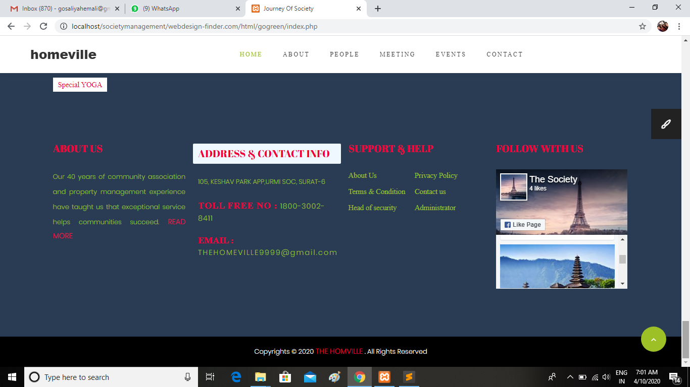
Footer

Slide 19
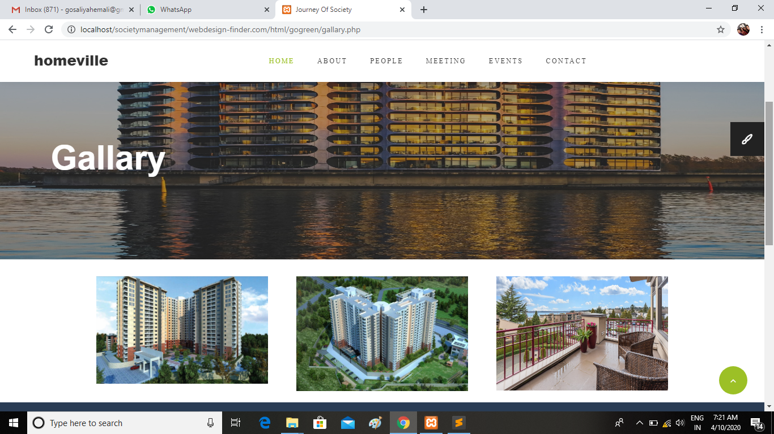
Galary

Slide 20
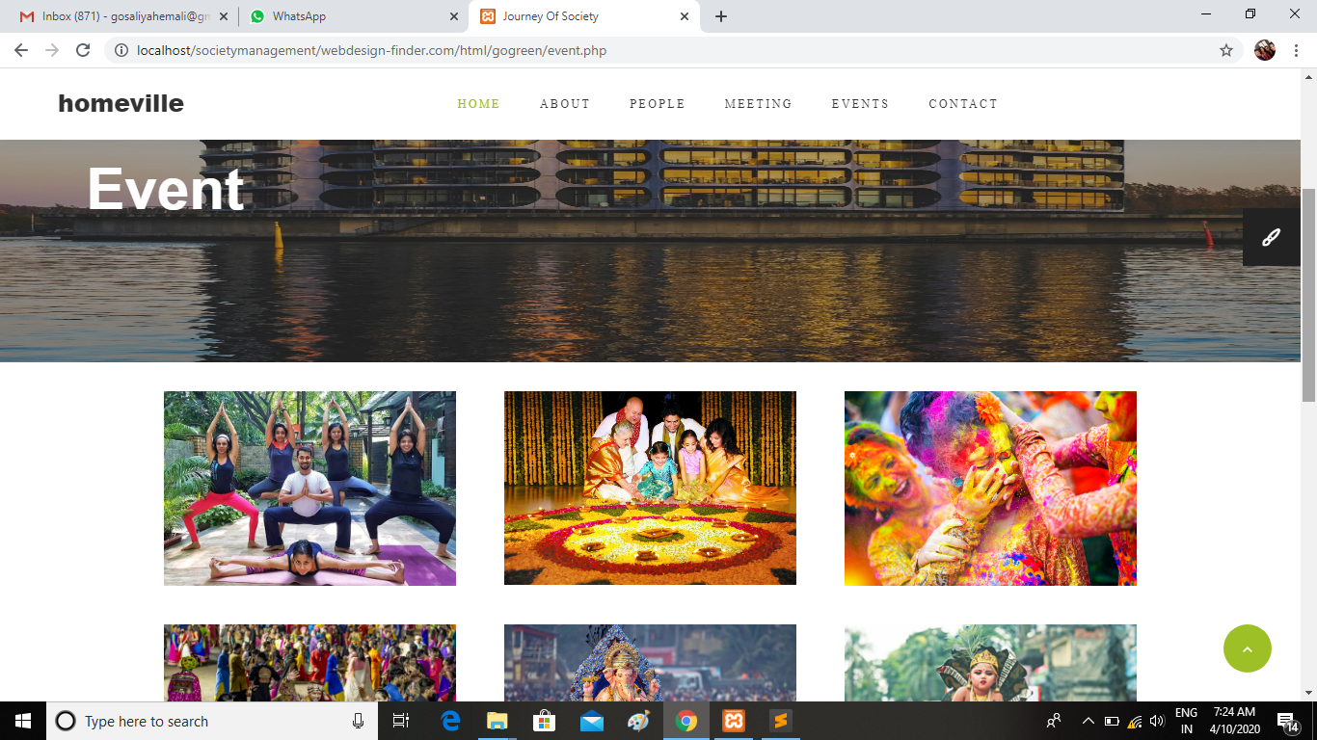
Event

Slide 21
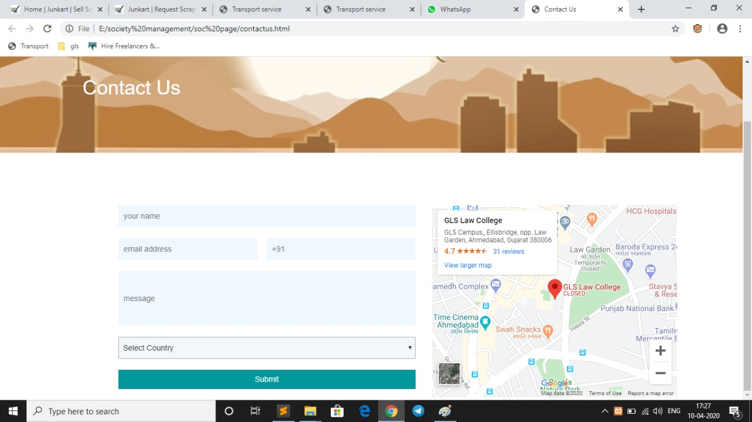
Contact Us

Slide 22
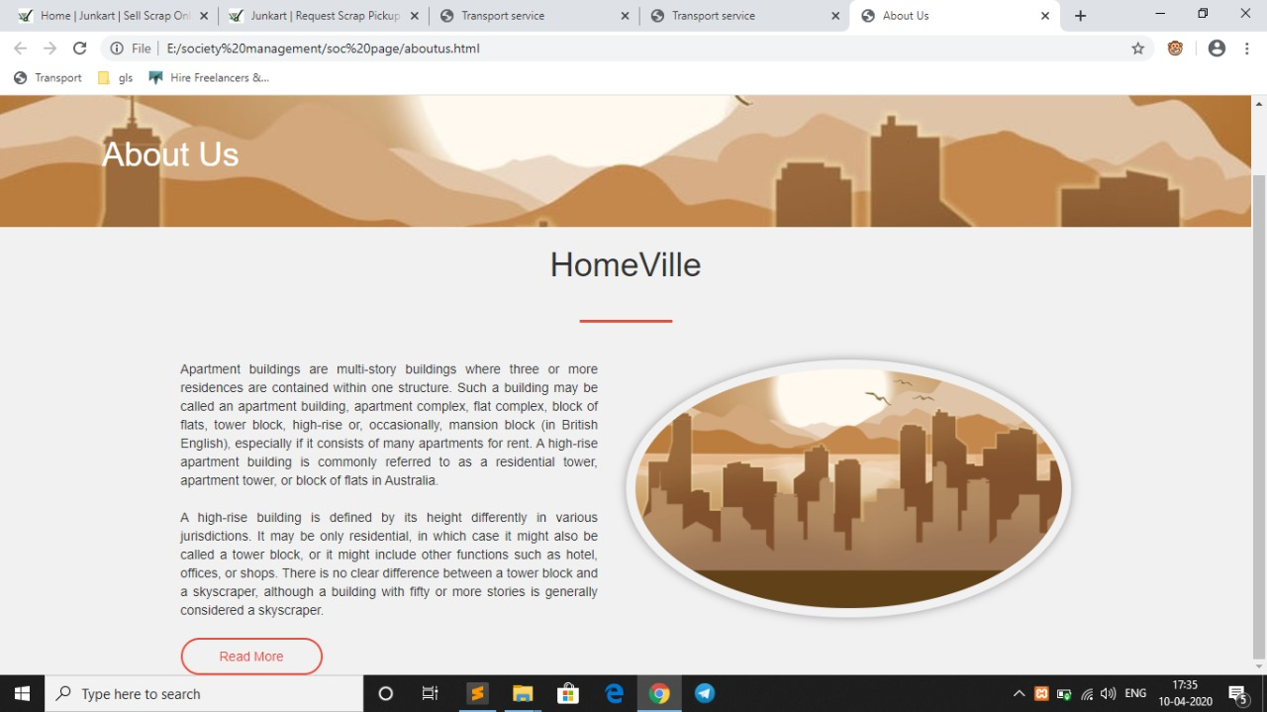
About Us

Slide 23
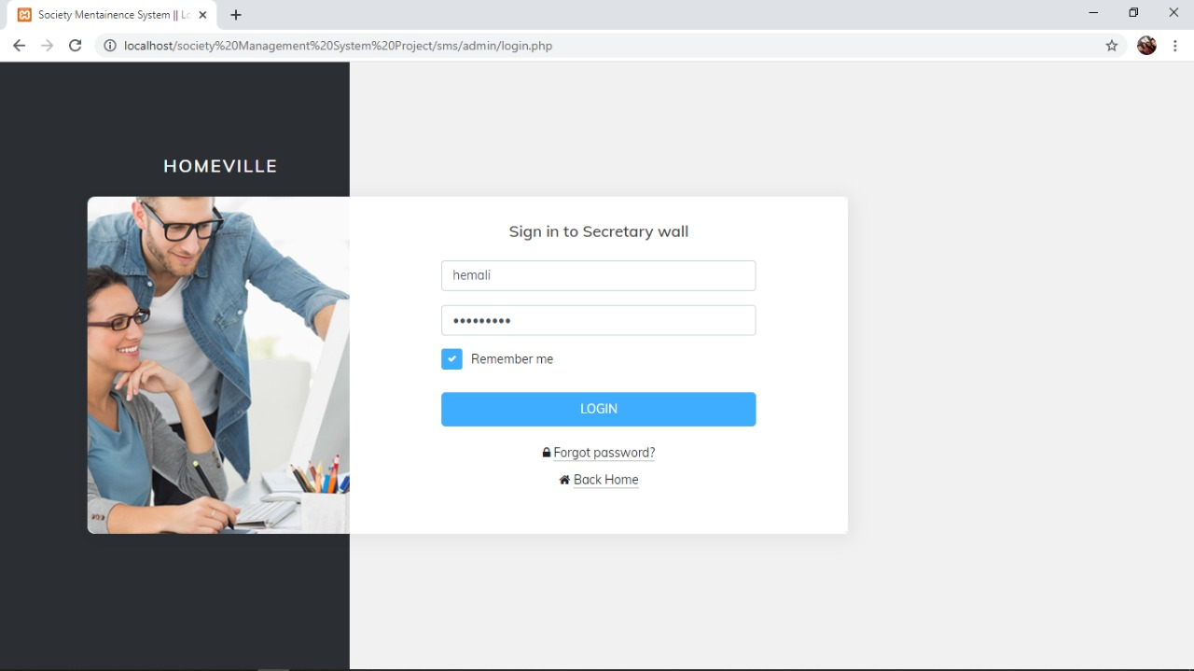
Secretary Login

Slide 24
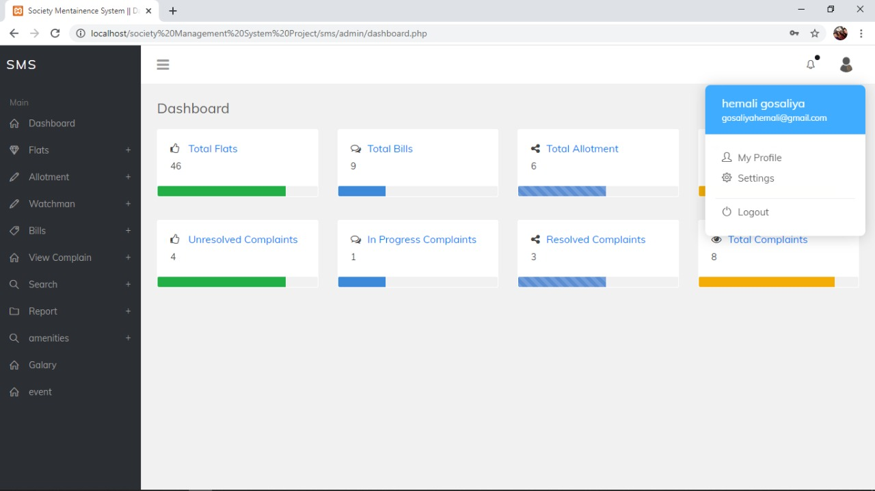
Secretary Dashboard

Slide 25
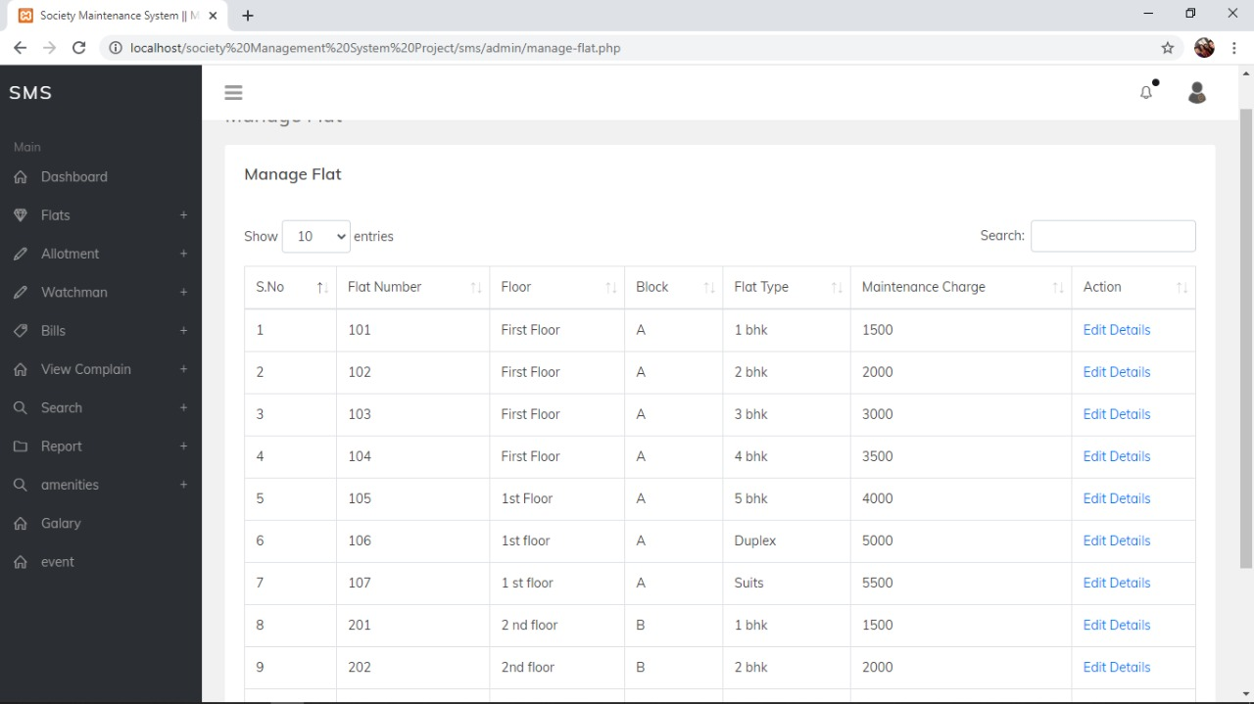
Secretary Can Add And Manage Flat

Slide 26
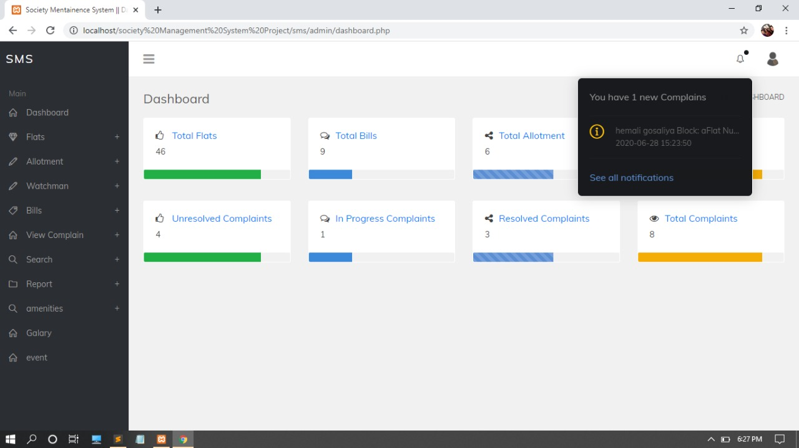
Secretary Can Manage And Solve All Notification Complain

Slide 27
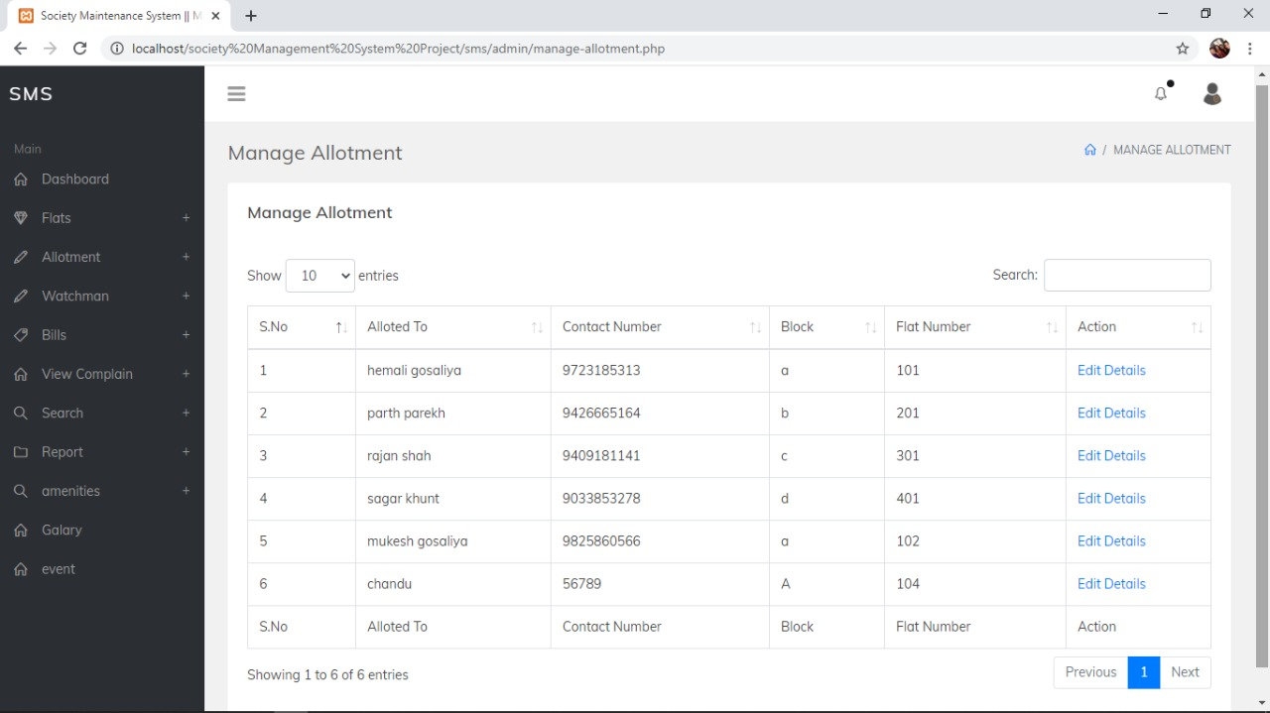
He Can Manage Allotement Detail

Slide 28
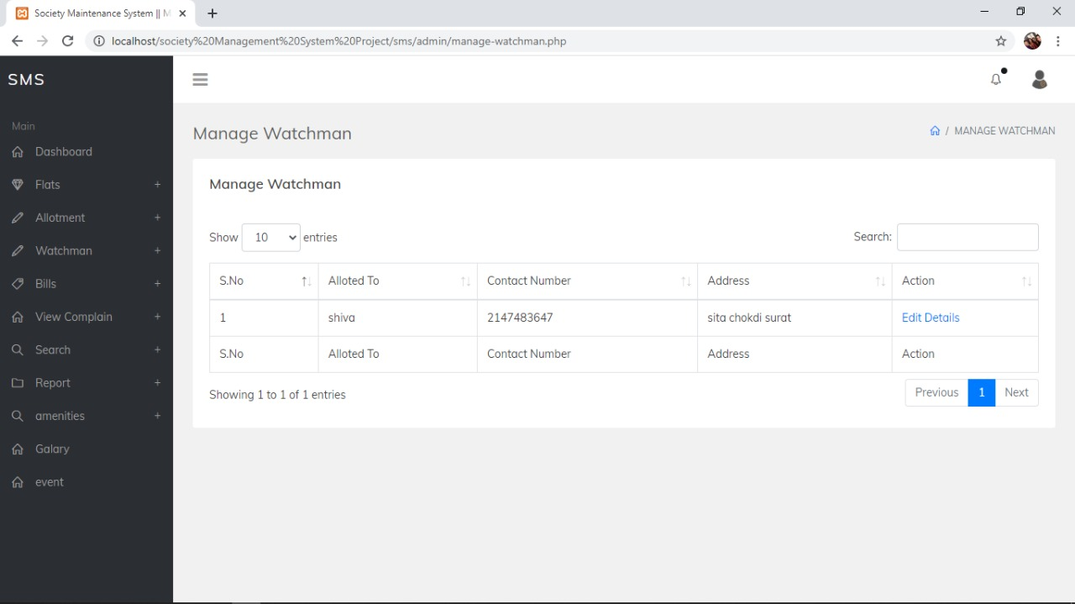
Manage Watchman And Staff Detail

Slide 29
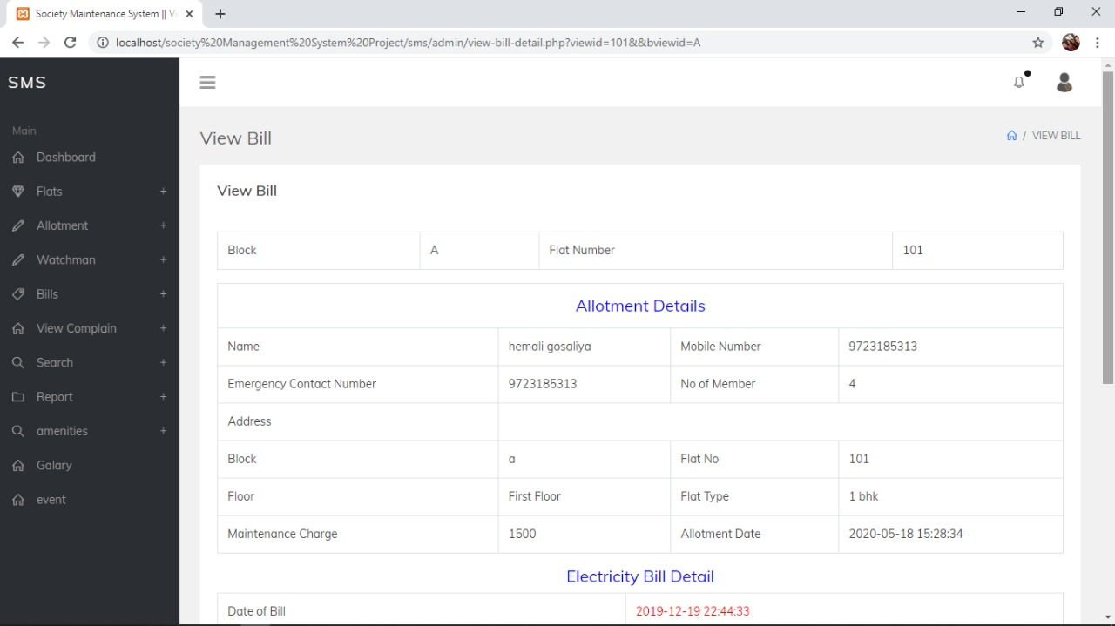
Manage Maintenance And Other Bill

Slide 30
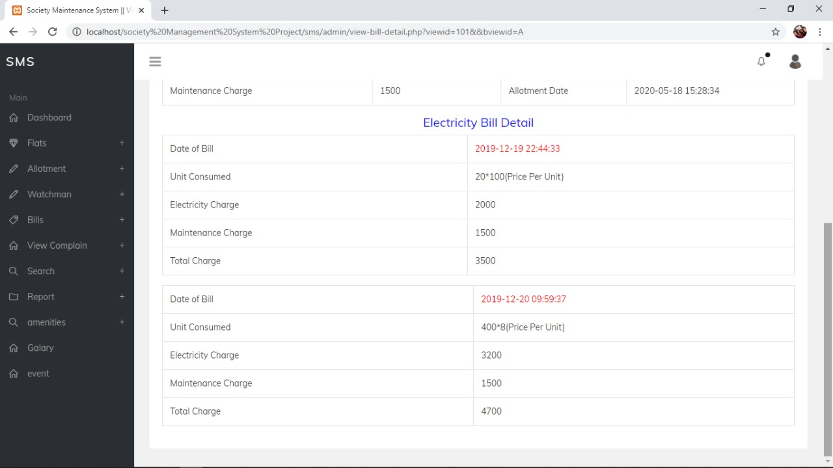

Slide 31
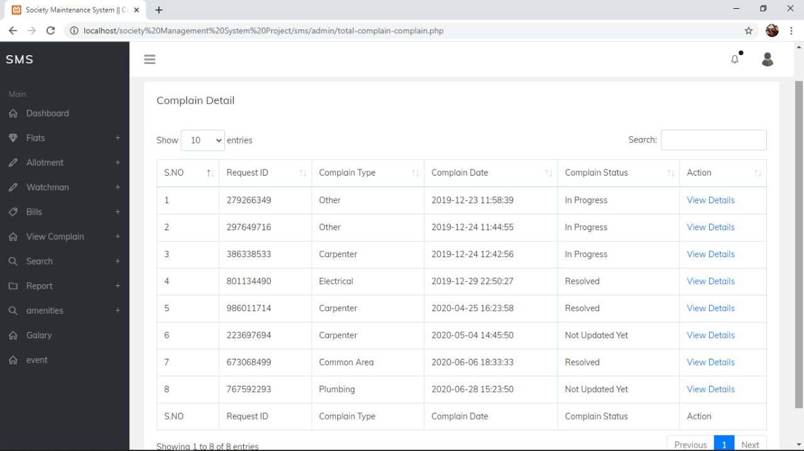
Manage Complain Detail

Slide 32
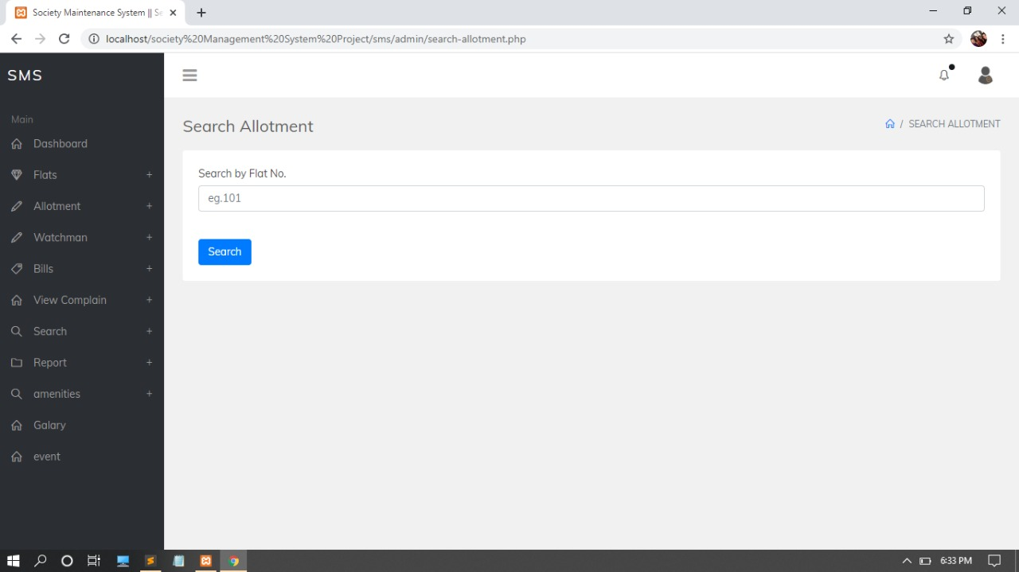
He Also Search The Allotment

Slide 33
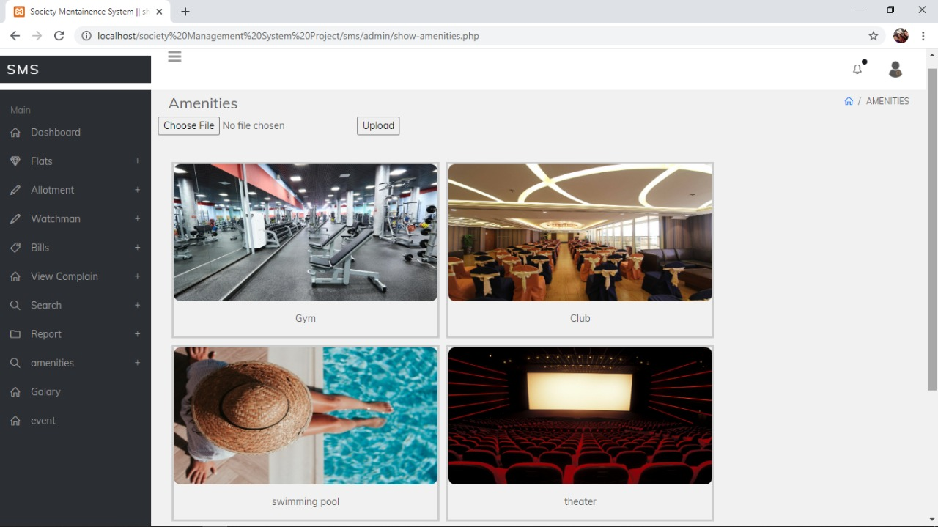
Manage Amenities And Also Book

Slide 34
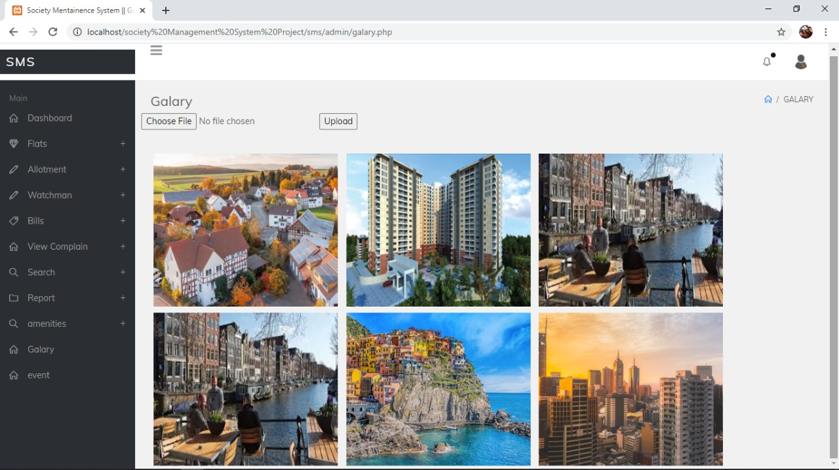
Homeville Gallary

Slide 35
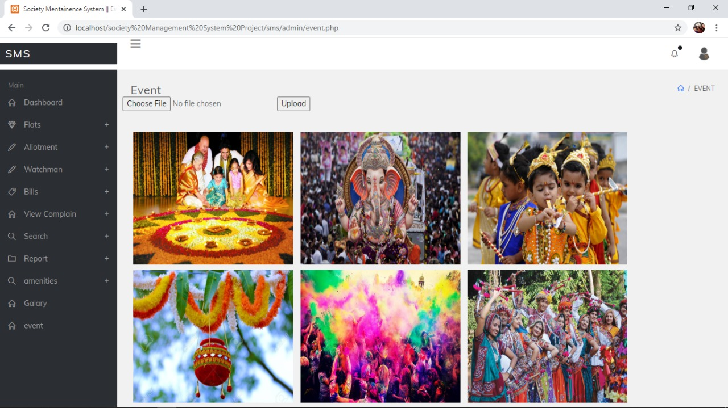
Manage Feature And Past Celebration

Slide 36
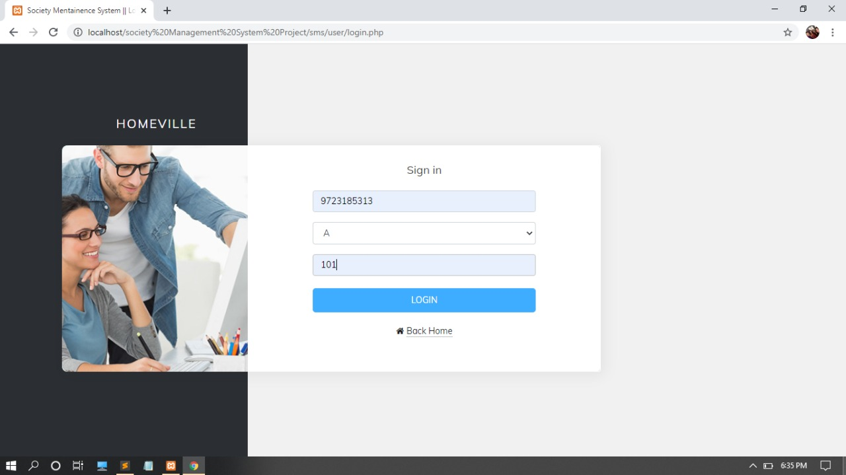
User Login

Slide 37
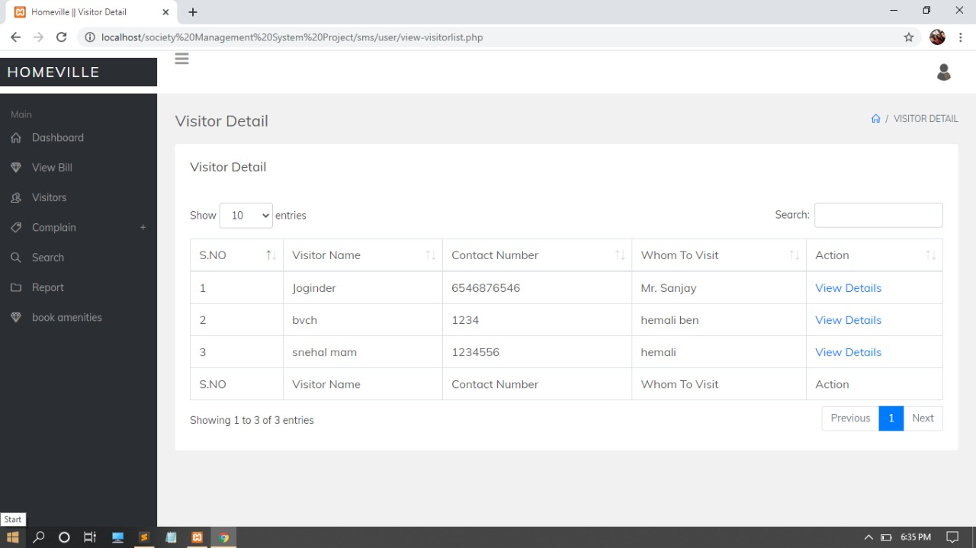
User Can View Personal Visitor Detail

Slide 38
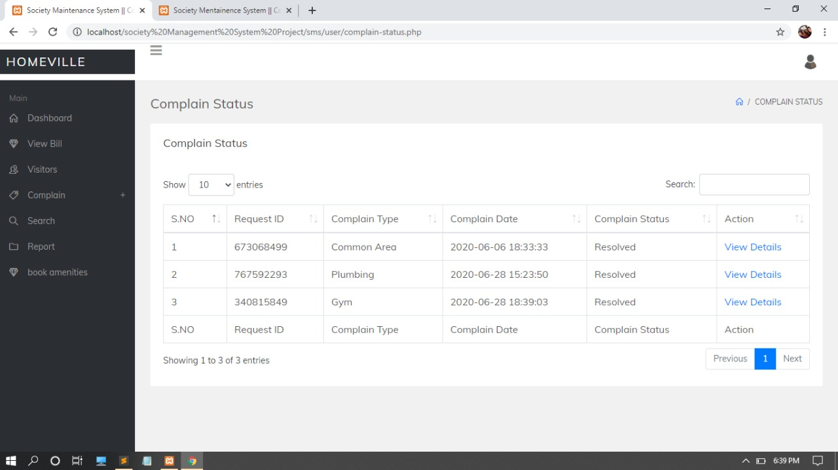
User Can Raise Complain And Check Status

Slide 39
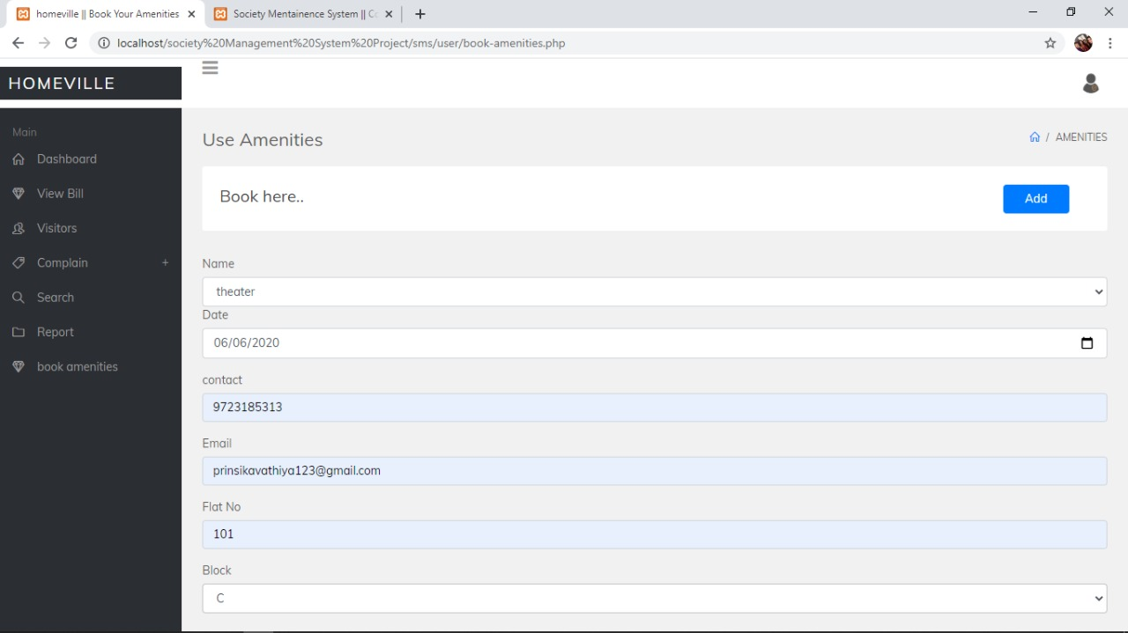
User Can Use Homeville Amenities

Slide 40
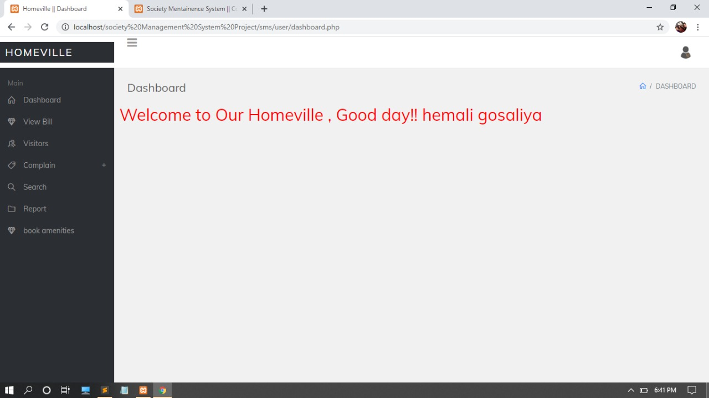
User Dashboard

Slide 41
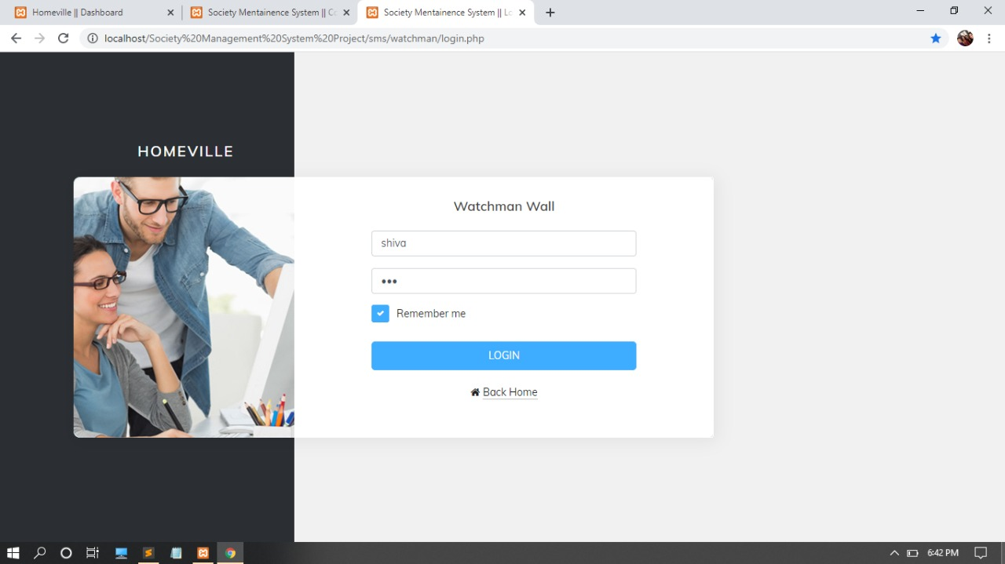
Watchman Login

Slide 42
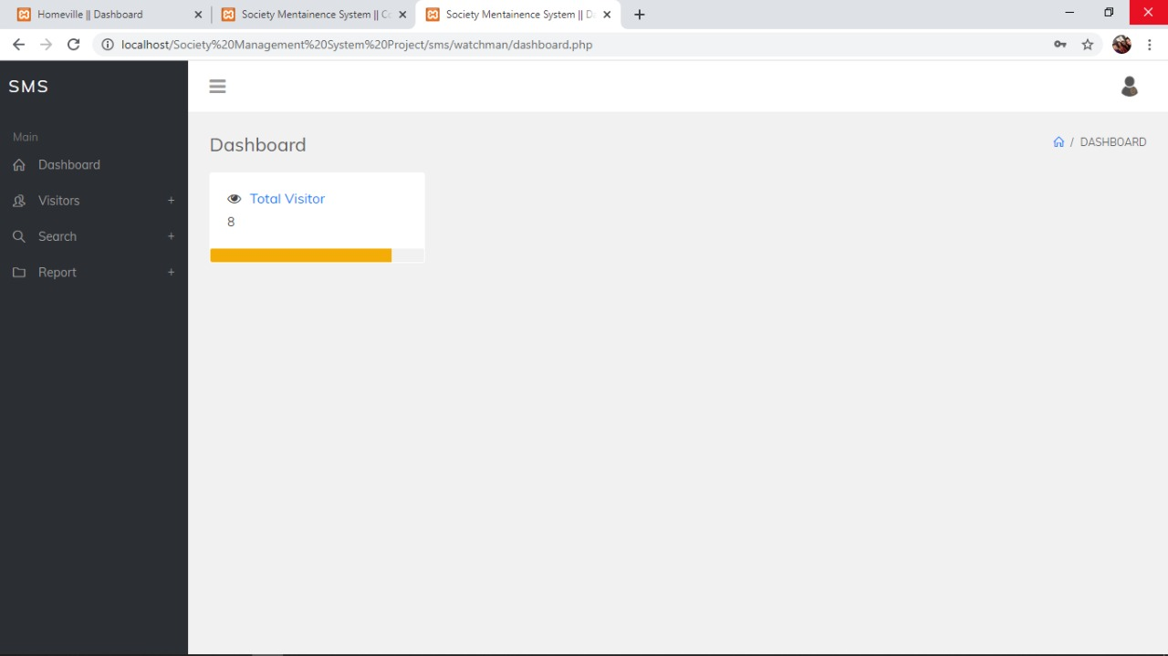
Watchman Dashboard

Slide 43
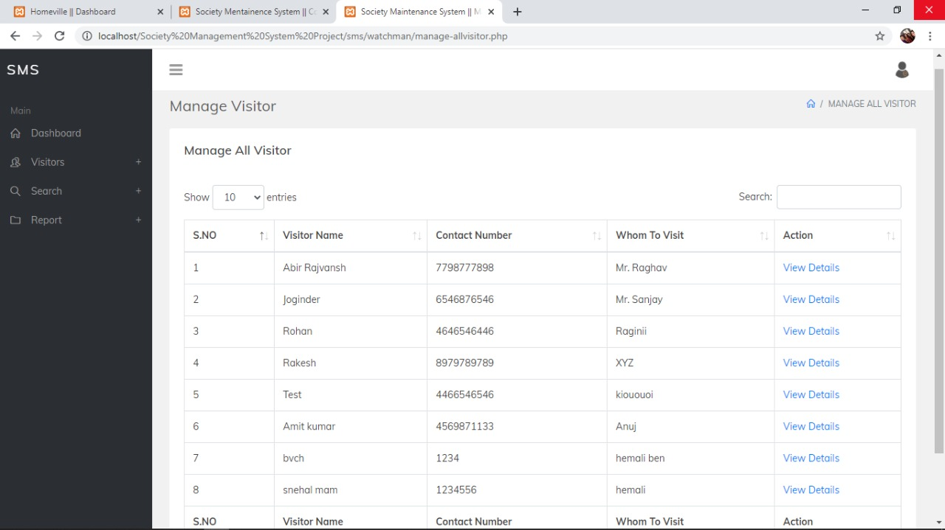
Watchman Show All Visitor

Slide 44
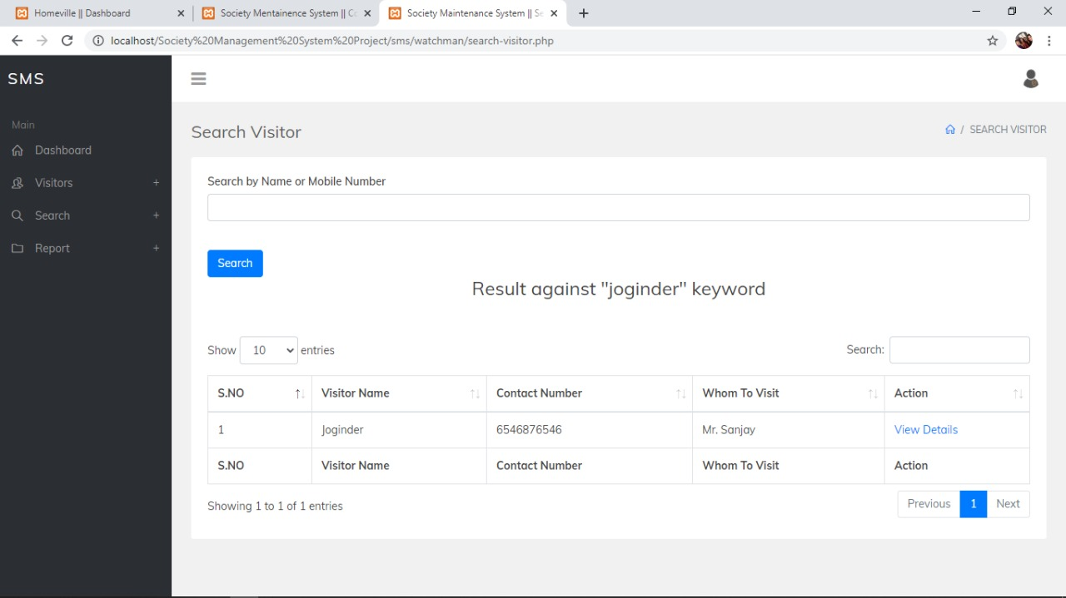
Manage Visitor And Also Search Visitor

Slide 45
THANK YOU

